Slide 1
A 2-approximation algorithm for the zookeeper’s problem
Xuehou Tan
Information Processing Letters 100 (2006) 183–187
Presenter: Chung-Han Chiang
Date: Nov, 2, 2006

Slide 2
ABSTRACT
Let P be a simple polygon, and let P be a set of disjoint convex polygons inside P, each sharing one edge with P.
The zookeeper’s route problem asks for a shortest route inside P that visits (but does not enter) each polygon in P.
We present an O(n) time algorithm for computing a zookeeper’s route of length at most 2 times that of the shortest zookeeper’s route. Our result improves upon the previous approximation factor 6.

Slide 3
INTRODUCTION
Zookeeper’s problem:
To find the shortest route to feed animals.
Time complexity:
O(n^2) →O(nlog^2n) →O(nlogn)
All of these exact algorithms are not only complicated but also far from practical.

Slide 4
INTRODUCTION (Cont.)
So, we have the approximation algorithms.
Because the approximation algorithms require only the computation of shortest paths inside the interior of the zoo. So they’re faster ( O(n) ) and simpler.
In this paper, we present an O(n) time algorithm for computing a zookeeper’s route of length at most 2 times that of the shortest zookeeper’s route.

Slide 5
Known solutions to the zookeeper’s problem
First, triangulate the interior of P −P
(Fig. 1(a)).
Next, unfold the triangulation using the edges of S as mirrors, in their order on the boundary of P , and find the shortest path between s and its image s in the unfolded polygon (Fig. 1(b)).
Finally, fold back the shortest path to obtain the locally optimal zookeeper’s route
(Fig. 1(c)).

Slide 6
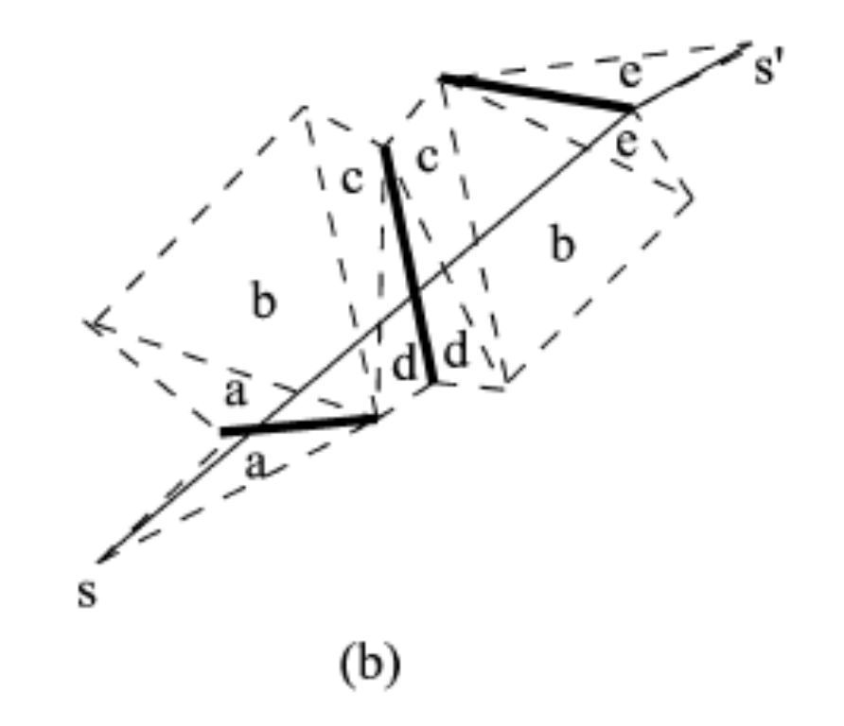
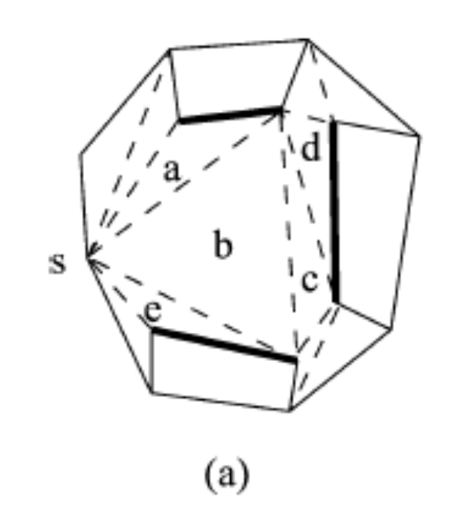
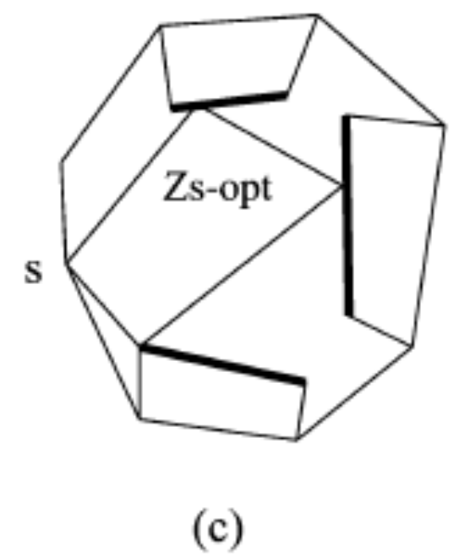
Known solutions to the zookeeper’s problem (Cont.)

Slide 7
Known solutions to the zookeeper’s problem (Cont.)
Lemma 1. There is a unique non-adjustable zookeeper’s route in the interior of the zoo (i.e., in P − P), except for very special cases where there is an infinite number of non-adjustable routes of equal length.
Lemma 2. A zookeeper’s route is a shortest zookeeper’s route if and only of it is non-adjustable.

Slide 8
The 2-approximation algorithm
Zs-app: be the zookeeper’s route through a point s, which is computed by the algorithm of [11].
Zs-opt: the shortest zookeeper’s route through s.
Z-opt: an overall shortest zookeeper’s route.
Theorem 1.: For any instance of the zookeeper’s route problem, we can find a point s on some cage of P such that |Zs-app| <= 2|Zopt| holds. Moreover, the route Zs-app can be computed in O(n) time.

Slide 9
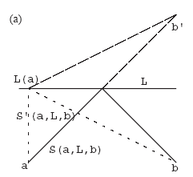
Proof.
Zs-app <=√2Zs-opt
S (a; L; b)= aL and Lb,
b’L = Lb,
S’ (a; L; b)= aL(a) and L(a)b’,
So,we knew that the length of S’ (a; L; b) is at most √2 times that of S (a; L; b).

Slide 10
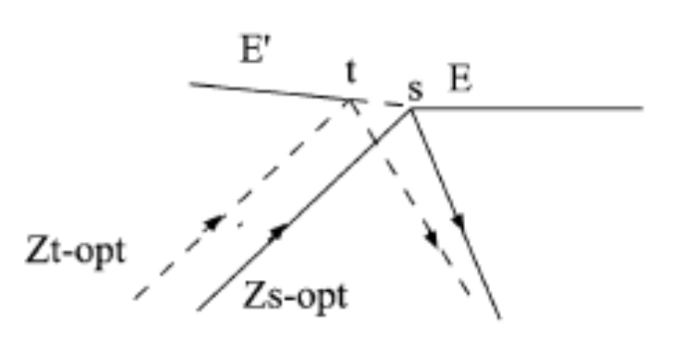
Proof. (Cont.)
Goal: Zs-opt <=√2Z-opt
If Zs-opt can’t be adjusted at s either, then we have Zs-opt = Z-opt.
Let t denote the event point next to s on the chosen cage P2 in the sliding process described in the previous section [8]. In the case that s is an endpoint of E, the point t is contained in a new edge E that also has s as its endpoint

Slide 11
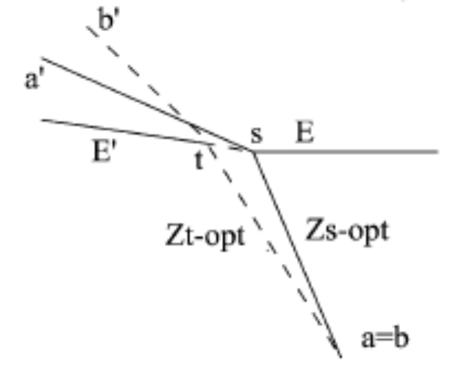
Proof. (Cont.)
Zt -opt can topologically be considered as two line segments bt and tb’
Zs -opt can topologically be considered as two line segments at and ta’
Zs-opt with E can exceed π/2.So E can exceed π/2, the angle asa’ of the triangle asa’ is at least π/2. Thus, |Zs-opt| = |as| + |sa| <= √2|aa|
Since the unfolded route Zopt can be considered as
a line segment, we have |aa’|<=|bb’|<= ··· <=|Zopt|.
Since |Zs-opt|<=√2|aa’| holds, we obtain |Zs-opt|<= √2|Zopt|. It completes the proof.

